Slide 1
OS Introduction 5 Resource Management
David Liu
Fall 2021, Spring 2022, Fall 2024

Slide 2
Learning Objectives
Discuss the role and importance of operating systems
Describe the general organization of a computer system and the role of interrupts
Describe the components in a modern, multiprocessor computer system
Illustrate the transition from user mode to kernel mode
Discuss how OS manages computing resources
Discuss how operating systems are used in various computing environments
Provide examples of free and open-source operating systems

Slide 3
Resource Management
Operating System manages computing resources: CPU, memory space, file-storage, I/O devices, etc.
Process management
Memory management
File-System management
Mass-Storage management
Cache Management
I/O System Management

Slide 4
Process Management
What is a process?
Is OS running as a process?
Resource for process
Program Counter:
How many program counters per process?
How many process can run at the same time?

Slide 5
Process Management Activities
Five Process Management Activities
Creating and deleting __________________________
Scheduling _____________________
Suspending and resuming ______________
______________ for process synchronization
______________ for process communication

Slide 6
Memory Management
All (or part) of the instructions must be in memory
All (or part) of the data that is needed by the program must be in memory
Purpose
CPU utilization
Response time

Slide 7
Memory Management Activities
Three MM Activities
Which process uses parts of memory
Allocate and deallocate
Which Parts of process or data into or out of memory

Slide 8
File-System management
Logical storage unit
Hierarchical directories

Slide 9
File-System management Four Activities
Creating and deleting files and directories
Primitives to manipulate files and directories
Mapping files onto secondary storage
Backup files onto stable (non-volatile) storage media

Slide 10
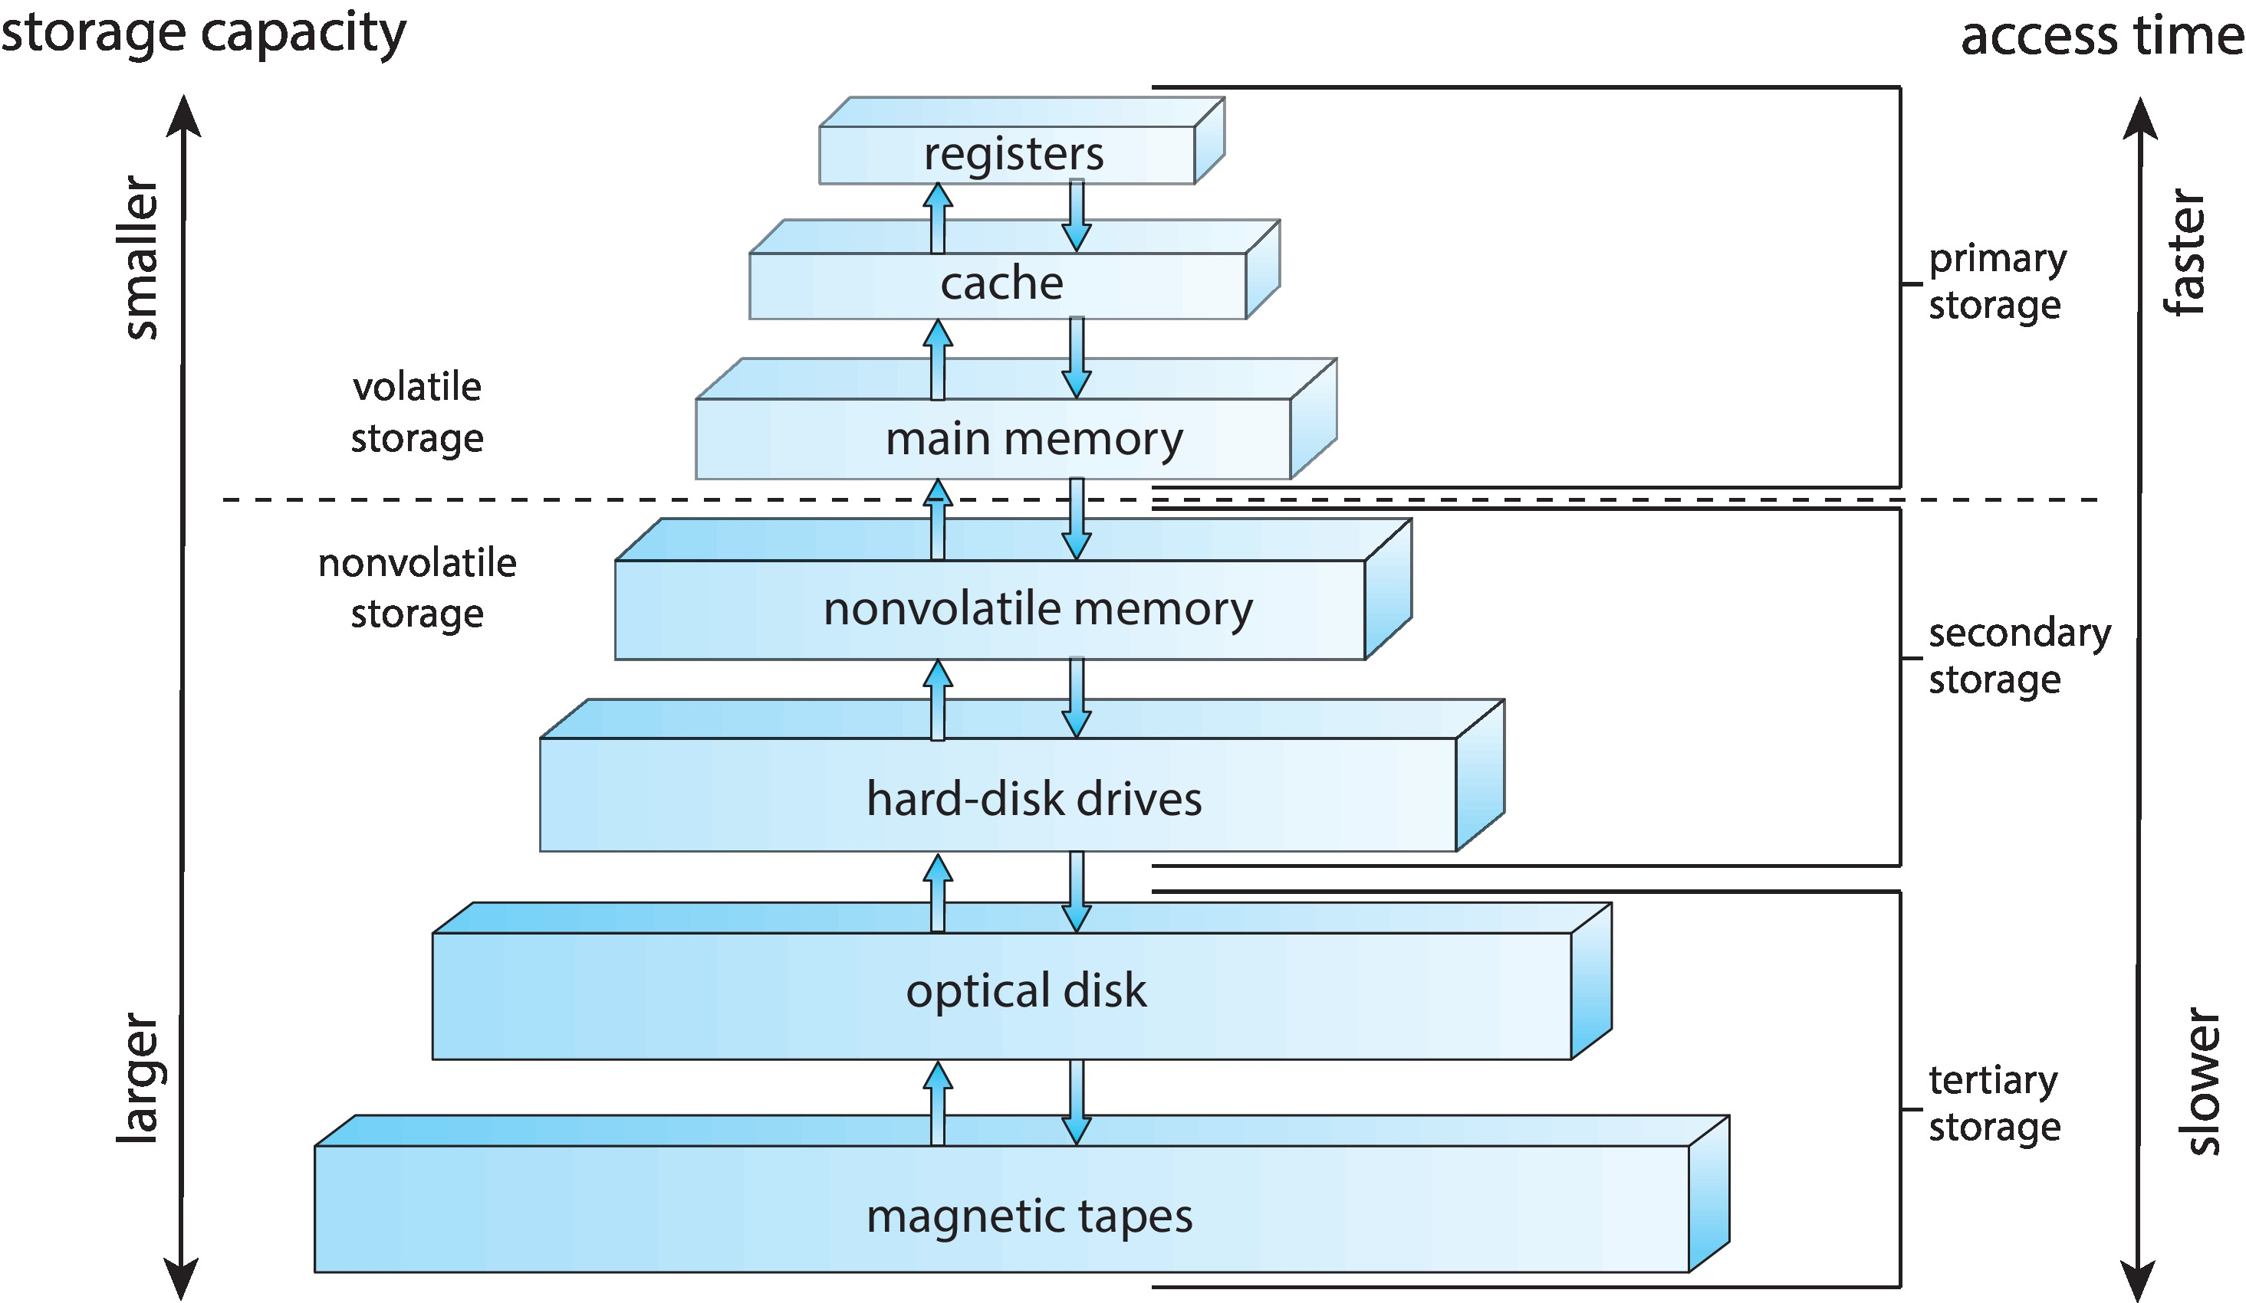
Mass-Storage management
Back up main memory
Both programs and data
Secondary and tertiary storage

Slide 11
Mass Storage Management Six Activities
Mounting and unmounting
Free-space management
Storage allocation
Disk scheduling
Partitioning
Protection

Slide 12
Cache Management
Source | Cache
Main memory | Cache (hardware)
Main memory | Registers (programmable)
disk | Main memory

Slide 13
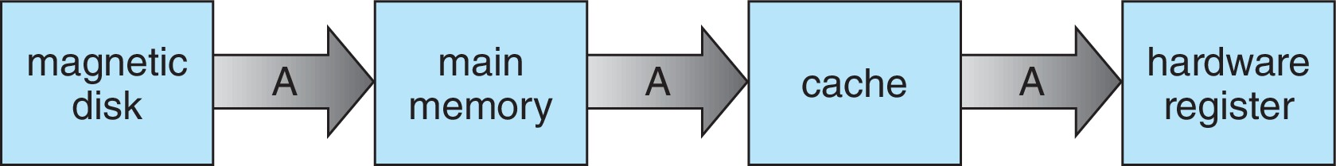
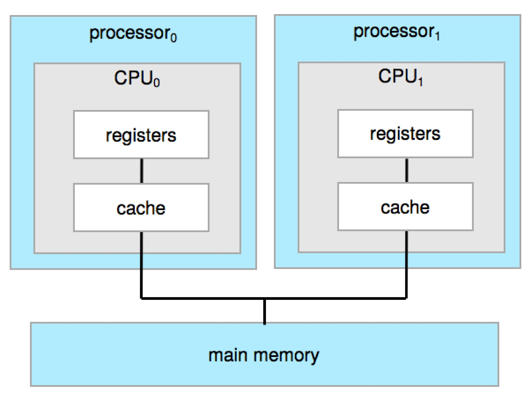
Cache Coherency
Single process vs multiprocesses
Multiprocessor

Slide 14
I/O System Management
Hide peculiarity of hardware devices from the users
Components
Memory management of I/O
Buffering
Caching
Spooling
General device-driver interface
Drivers for specific hardware devices

